Slide 1


New Frontiers in Physics
Richard Lasky – Summer 2010

Slide 2
Higgs Boson
http://www.youtube.com/watch?v=1_HrQVhgbeo&feature=related
http://www.youtube.com/watch?v=RFGpNMe5eEQ&feature=related

Slide 3
Dark Matter
http://www.youtube.com/watch?v=6p8T9fkgBgE&feature=related
http://www.youtube.com/watch?v=yYv62-mWitI&feature=related
http://www.youtube.com/watch?v=3SiGujnfDVc&feature=related

Slide 4
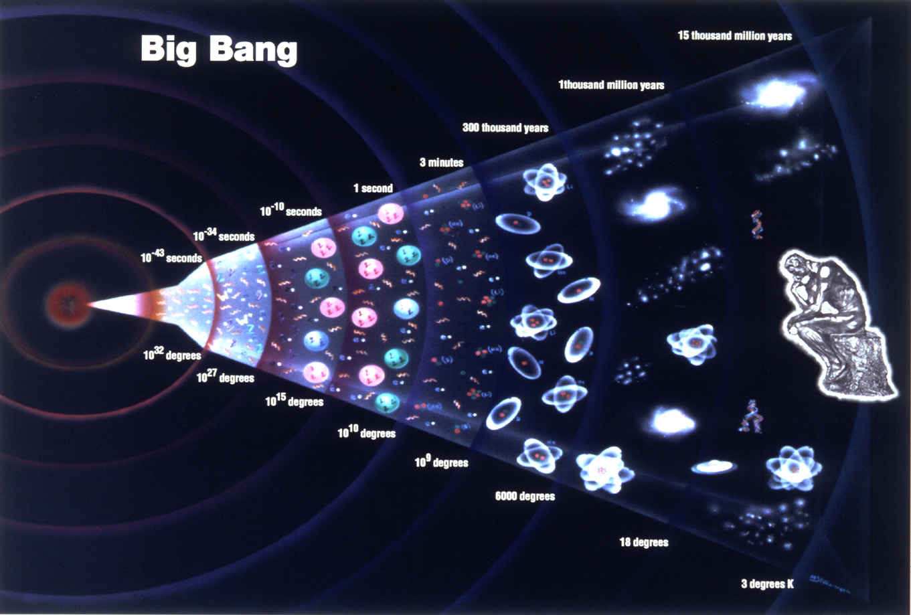
Standard model of the stages of the universe

Slide 5
Big Bang
http://www.youtube.com/watch?v=hSZqhqR5XKM&NR=1

Slide 6
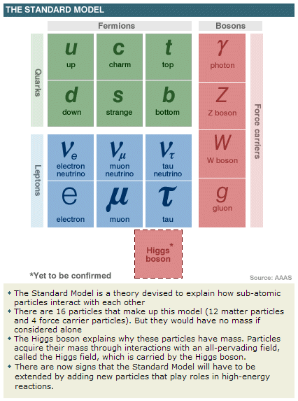

Slide 7
Study of Neutrinos
The study of Neutrinos is conducted around the world
The atmospheric neutrinos are produced in some of the same reactions as the muons that we have been studying

Slide 8
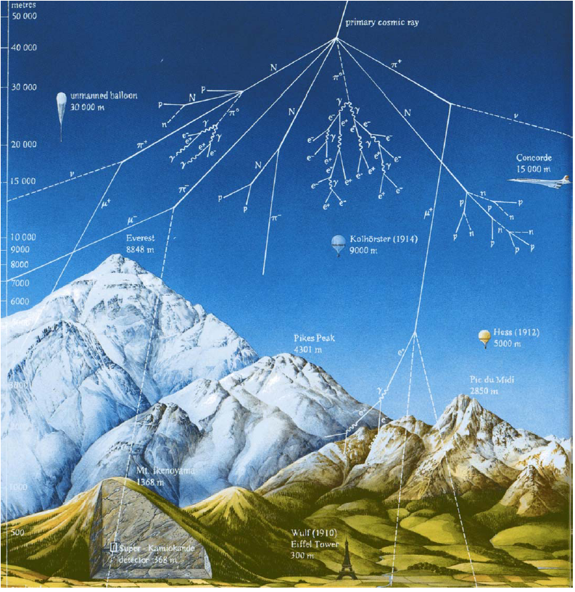
Production of Atmospheric Neutrinos

Slide 9
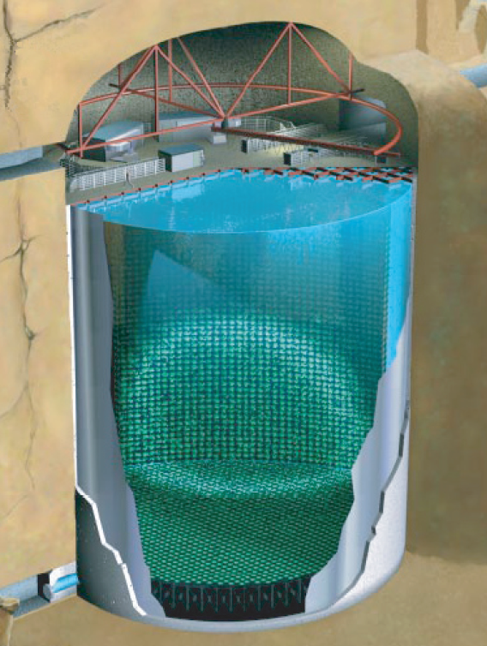
Super-Kamiokande
Located in Kamioka, Japan
50 kT water Cerenkov detector (22.5 kT fiducial)
~12000 PMTs
Overburden of 2700 mwe
Separate muons and electrons by Cerenkov ring structure

Slide 10

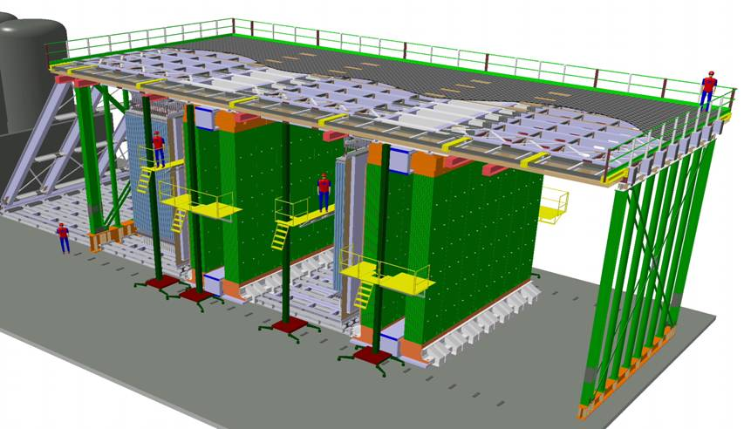
Opera
μ spectrometer
Magnetised Iron Dipoles
Drift tubes and RPCs
ν_{τ}
Target:
- a “wall” of Pb/emulsion “bricks”
- planes of orthogonal scintillator strips

Slide 11
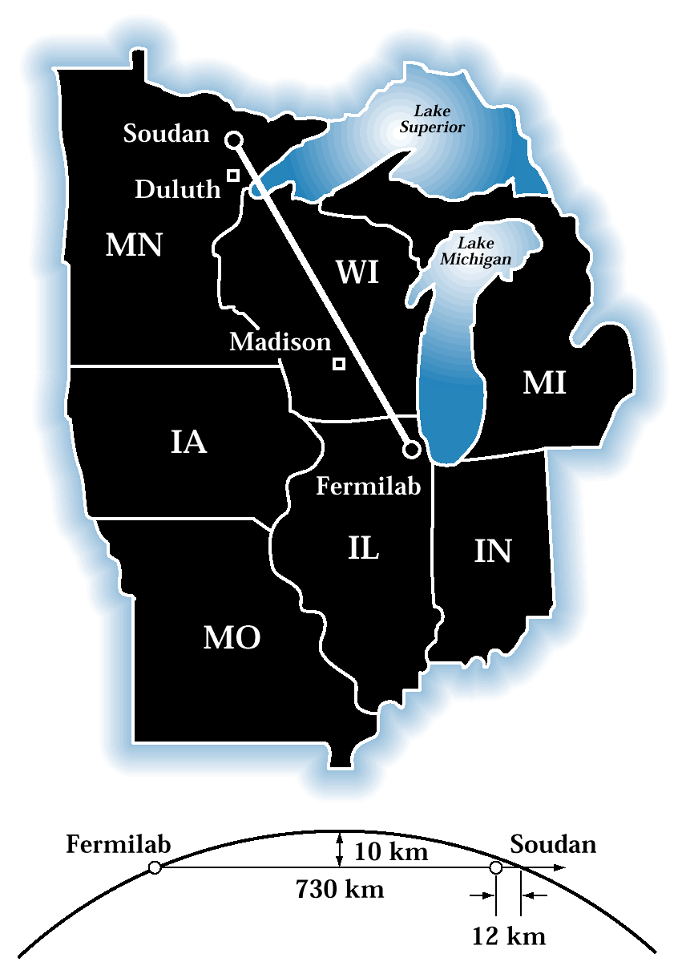
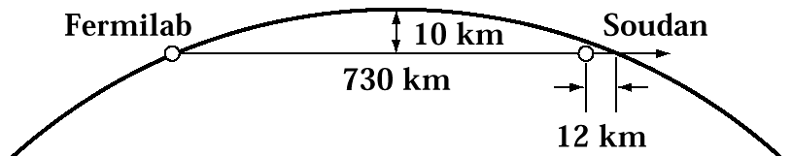
MINOS at Femilab
735 km baseline
Two magnetised iron-scintillator tracking calorimeters
  Near detector at Fermilab
  Far detector at Soudan Underground Lab.
Near Detector:
980 tons
Far Detector:
5400 tons
Det. 1
735 km
Det. 2

Slide 12
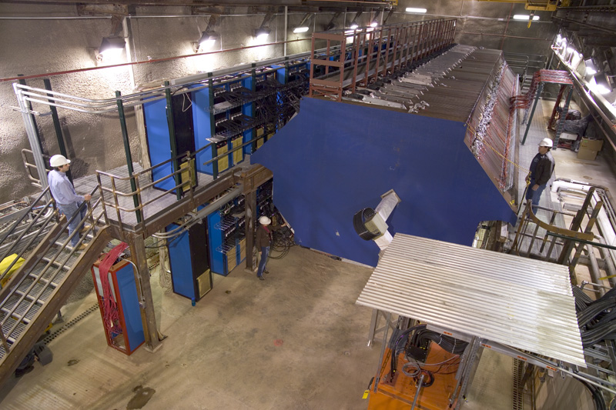
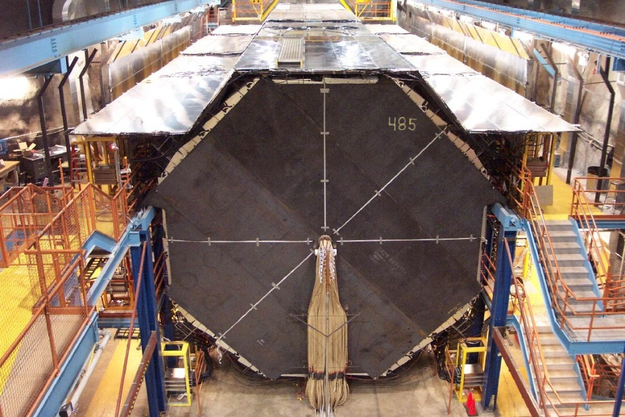
The MINOS Detectors
Near Detector, 980 tons
Far Detector, 5400 tons
Identical in important features:
  2.54 cm thick steel planes
  1 cm thick scintillator planes
  1.5 T magnetic field

Slide 13
MINOS Detectors
Both MINOS detectors are steel-scintillator sampling calorimeters made out of alternating planes of magnetized steel and plastic scintillators. The magnetic field causes the path of a muon produced in a muon neutrino interaction to bend, making it possible to distinguish interactions with neutrinos from those with antineutrinos. This feature of the MINOS detectors allows MINOS to search for CPT-violation with atmospheric neutrinos and anti-neutrinos.

Slide 14
Sudbury Neutrino Observatory (SNO)
Sudbury, Ontario, Canada
The Sudbury Neutrino Observatory (SNO) results have provided revolutionary insight into the properties of neutrinos and the core of the sun
6800 feet under ground, in INCO's Creighton mine near Sudbury, Ontario, Canada
SNO is a heavy-water Cherenkov detector designed to detect neutrinos produced by fusion reactions in the sun which produce light flashes
This light is then detected by an array of 9600 photomultiplier tubes
http://www.youtube.com/watch?v=WE565jXuVuM&feature=related

Slide 15
Summary of Neutrino research
It’s now 40 years since the first atmospheric neutrinos were detected
First detected, via neutrino-induced muons, in 1965
First fully contained events in early 1980s
    Proton decay experiments

Slide 16
Worm Holes
http://www.youtube.com/watch?v=GbY8vqIhAms&feature=channel
http://www.youtube.com/watch?v=VKk2aZS0bl4&feature=related

